Slide 1
Developing critical thinking skills
Dr Andrew Reeves
Centre for Learning and Study Support (CLaSS)

Slide 2
Becoming a Critical Thinker
Critical Thinking is “one of the hallmarks of academic study” and “is considered particularly important in Western universities” (Davies, 2011)
What do you understand by “Critical Thinking”?
Davies, M., 2011. Study Skills for International Postgraduates. Basingstoke: Palgrave Macmillan.
“A critical thinker is someone who has an interest and ability to engage in intellectual arguments. It is someone who thinks actively, and who investigates information carefully. He or she does not accept things without analysing the information and checking if it is true or not…” Davies 2011

Slide 3
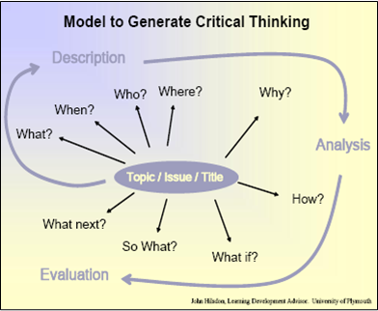
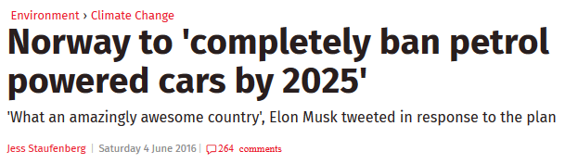
Generative Questions

Slide 4
Generative Questions
Key point: good writing comes
from time spent thinking
touching on description, analysis
and evaluation
In use:
Students use for individual thinking
Facilitated conversation – directing students towards enough coverage of each aspect
Outputs:
Description: greater clarity; ideas of what could be otherwise
Analysis: tentative explanations to guide reading
Evaluation: initial ideas towards argument and conclusion

Slide 5



Three Voices
Content
The Tour Guide Voice
This voice guides your reader through your essay outlining the point you are exploring in this paragraph. The voice may sound like:
“This essay will now consider how …”
The Expert Voice
This voice belongs to the experts you have found in your reading. This often features as a direct quote or a paraphrase. You will still need to introduce the expert though, which may sound like:
“According to Sahad (2015), [include your quotation/paraphrase here] …”
The Argument
This voice is where you argue the case for particular ideas, considering and building upon the expert voice in relation to your own thinking and your assignment brief. It may sound like:
“What this perspective seems to suggest is …”

Slide 6

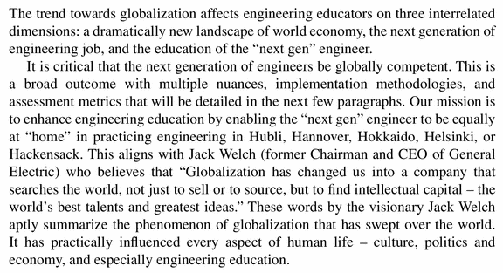
Academic writing example
Where is the Tour Guide; Expert; Argument?
From Bidanda, B. (2014). Engineers without borders. Proceedings of the International Conference on Transformations in Engineering Education. Ed. R. Natarajan. pp 77-79.

Slide 7
Academic writing example
Where is the Tour Guide; Expert; Argument?
From Bidanda, B. (2014). Engineers without borders. Proceedings of the International Conference on Transformations in Engineering Education. Ed. R. Natarajan. pp 77-79.
Notes:
Note – we didn’t all agre

Slide 8
Three Voices
Key point: critical writing involves linkages between evidence and argument
In use:
Highlight different voices in draft paragraphs – identify gaps
Use as framework for discussion – e.g. where there is a lack of evidence, or where argument is absent to build on evidence
Outputs:
Stronger understanding of critical thinking
Improved academic writing

Slide 9




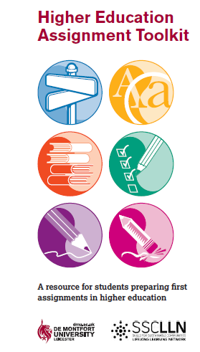
Centre for Learning and Study Support Enhancing academic practice, writing development and professional skills
Tutorials and Drop-in
Workshops
Workshops run regularly: Keep an eye out on blackboard and MyDMU to see our upcoming sessions
To sign up go the library what’s on page: www.library.dmu.ac.uk/Home/Calendar
Book a 30 minute one-to-one appointment to discuss any aspect of your study or work: visit the Library “What’s on?” page to book.
Just a quick question? Drop in every Monday, Wednesday, Friday 2-3pm or Tuesday, Thursday 5-6pm in the LDZ Kimberlin library where CLaSS will be waiting to answer your question!
Guides
HEAT, “Focus On” and more…
To view our online resources go to: www.library.dmu.ac.uk/link/CLASS
To help fit the pieces of your study together visit: www.library.dmu.ac.uk/link/CLASS

